Slide 1

Data Communication and Computer Networks
10. Link Layer
PART-C
Dr. Aiman Hanna
Department of Computer Science & Software Engineering Concordia University, Montreal, Canada
These slides has mainly been extracted, modified and updated from original slides of : Computer Networking: A Top Down Approach, 6th edition Jim Kurose, Keith Ross Addison-Wesley, 2013
Additional materials have been extracted, modified and updated from: Understanding Communications and Networking, 3e by William A. Shay 2005
Copyright © 1996-2013 J.F Kurose and K.W. Ross
Copyright © 2005 William A. Shay
Copyright © 2018 Aiman Hanna All rights reserved
Link Layer C

Slide 2
Connecting Networks
the larger the number of devices in a single LAN, the higher the chances that the LAN performance degrades
one possible solution is to separate devices into multiple LANs
yet, these LANs need to be connected for the devices to communicate

Slide 3
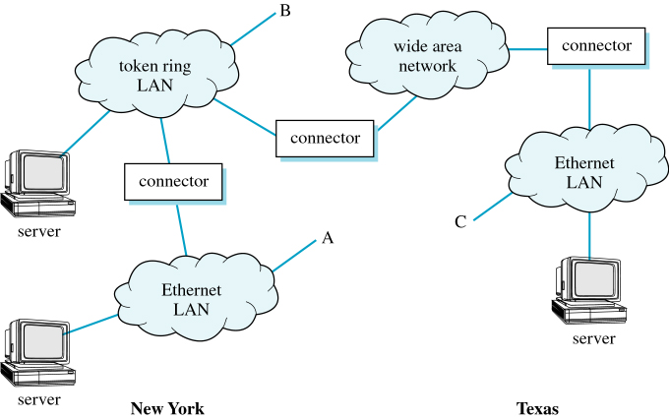
Connecting Networks
Interconnecting Networks

Slide 4
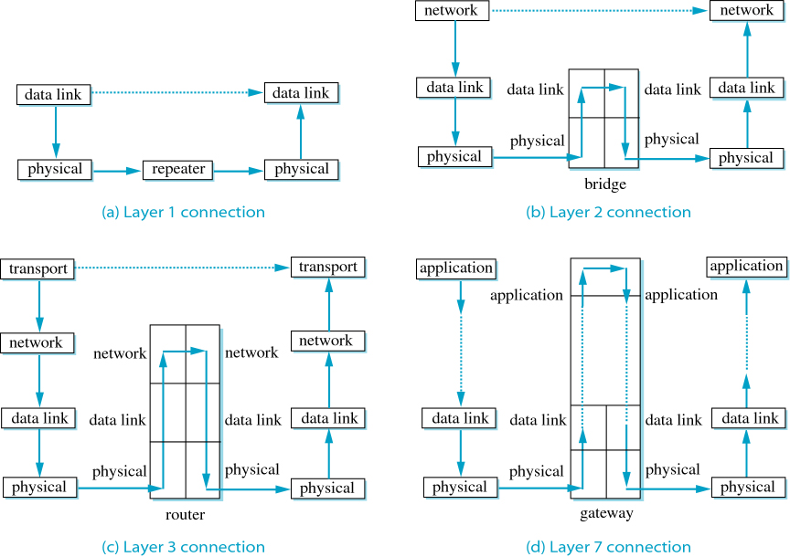
Connecting Networks
OSI Connections

Slide 5
Connecting Networks
protocol converters are used to connect different networks
the most common protocol converters exist at layers 1, 2 & 3
at layer 1: hubs, repeaters
at layer 2: bridges, switches, …
at layer 3: routers

Slide 6
Layer 1 Connections
Repeaters
operate at the physical layer (layer 1)
connect LANs that are using the same protocol and frame format
main function is to just regenerate signals then send them again, hence extend the distance covered by a LAN protocol

Slide 7
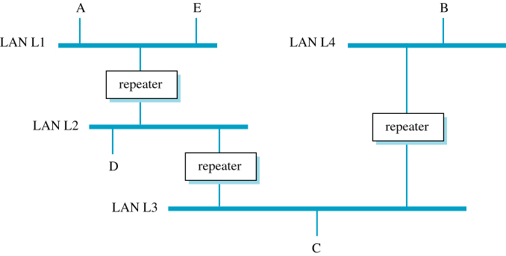
Layer 1 Connections
Repeaters
LANs Connected with a Repeater

Slide 8
Layer 1 Connections
Hubs
sometimes called multi-port repeaters
the main difference between a hub and repeater is that a hub has multiple ports, hence many devices can directly be connected to it
all devices connected to a hub are still in the same collision domain
the more the devices connected to hubs, the more the chances that the network performance will degrade

Slide 9
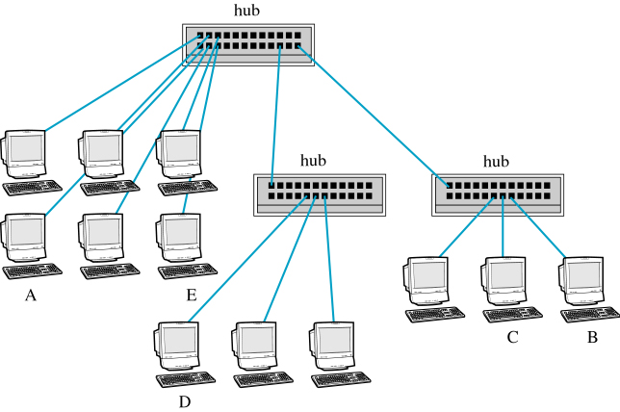
Layer 1 Connections
Hubs
Making Connections Using Hubs

Slide 10
Layer 2 Connections
Bridges
a bridge connects two LANs
operate at layer 2; so they are capable of:
Making decision about when to forward any frame they received
Performing data link function such as error detection, frame formatting, frame routing, …etc.
a bridge examines an incoming frame and route it to its LAN only if it is destined to a device in that LAN

Slide 11
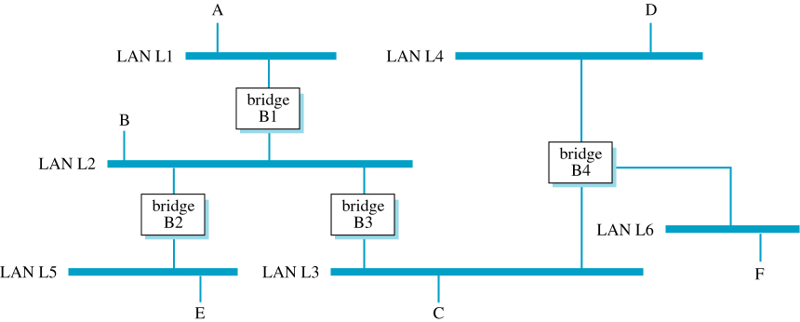
Layer 2 Connections
Bridges
LANs Connected through Bridges
** notice that there is an error in the above image. What is it?

Slide 12
Layer 2 Connections
Bridging different types of LANs
a bridge may connects two LANs of different types
this is more difficult however since many issues must be considered:
what if the two LANs operate on different speed
how about bridges delay; will they cost any further problems
what if the frame formats of the two network are different

Slide 13
Layer 2 Connections
Bridges - Routing
how would a bridge know that a specific device is in its LAN
worst, what if the device is not in the bridge's LAN but the frame must be passed by the bridge to another in order to deliver the frame
what if a device is initially served (either directly or indirectly) by a bridge but then the device is moved
the process of deciding which frames to accept/forward and where to forward them is called bridge routing

Slide 14
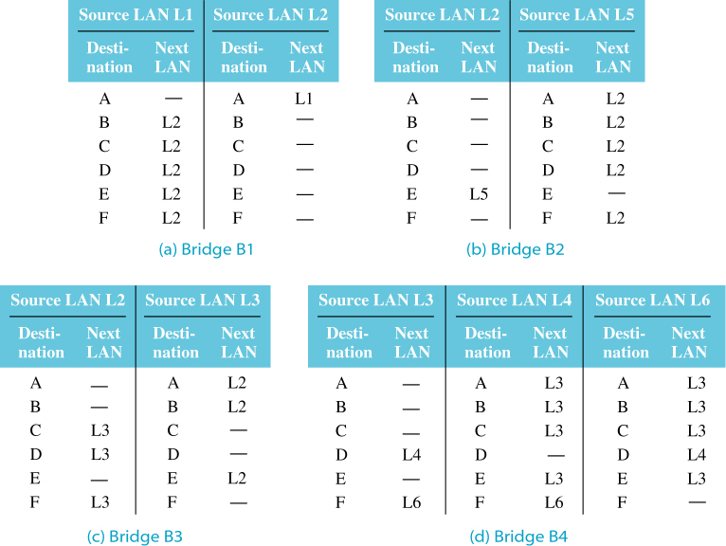
Layer 2 Connections
Bridges – Routing Tables
routing decision are made based on a routing table
each bridge has a routing table for each LAN it connects to
Routing Tables for Bridges in Previously Shown LANs

Slide 15
Layer 2 Connections
Bridges – Routing Tables
how does a bridge defines it routing table?
fixed routing: program the bridge with each device address and the LAN to which a frame should be forwarded to
fixed routing however is not that feasible in reality since changes are always possible (remove device, add device, ..etc.)
to accommodate more dynamic environment, either:
keep in changing the routing table whenever a change is done, or
determine some way for the bridges to update their routing tables automatically
the first alternative is not that viable in a more dynamic environment
bridges that are capable of creating and updating their routing tables automatically are referred to as transparent bridges

Slide 16
Layer 2 Connections
Bridges - Transparent Bridges
bridge that are capable of creating and updating their routing tables
once plugged, they can immediately work regardless of the topology or device locations
determine location of devices automatically then create/update the routing tables
if devices move, the tables are also automatically updated (by the bridges)
the capability to update routing tables automatically is referred to as route learning or address learning

Slide 17
Layer 2 Connections
Bridges – Route Learning
bridge creates routing table by observing traffic
when a frame is received, the bridge can know two things:
address of device
the LAN from which the frame came from
the bridge then examines its routing table to confirm that this information matches the table entries for that device
if not, the bridge updates the routing table to match the latest configuration

Slide 18
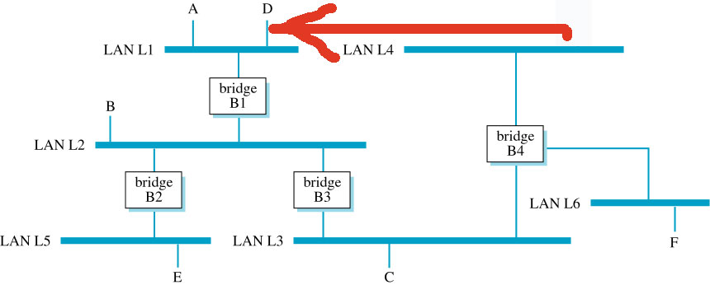
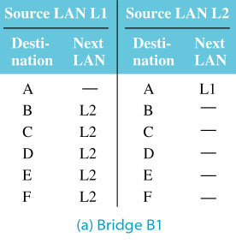
Layer 2 Connections
Bridges – Route Learning
Example:
→ device D moved from L4 to L1
Modified version of Previously Shown LANs D moved from L4 to L1
OLD Routing Table of B1 before moving D from L4 to L1

Slide 19
Layer 2 Connections
Bridges – Route Learning
Example (continues…):
→ After moving, device D sent a frame to E
Source LAN L1 |  | Source LAN L2
Destination | Next LAN | Destination | Next LAN
A | -- | A | L1
B | L2 | B | --
C | L2 | C | --
D | -- | D | L1
E | L2 | E | --
F | L2 | F | --
Updated Routing Table for B1

Slide 20
Layer 2 Connections
Bridges – Route Learning
Questions:
What if D never sent a frame?
What about the table of B4; is it updated!
Another question: What happens at startup when all tables are empty?

Slide 21
Layer 2 Connections
Bridges – Route Learning
each bridge maintains a timer; once this timer expires, it purges its routing table
this action makes the devices inaccessible
however, once a bridge receives a frame for a device that has no entry in the routing table, it uses a flooding algorithm
spanning tree is constructed for controlled flooding, in a similar fashion to what we discussed before

Slide 22
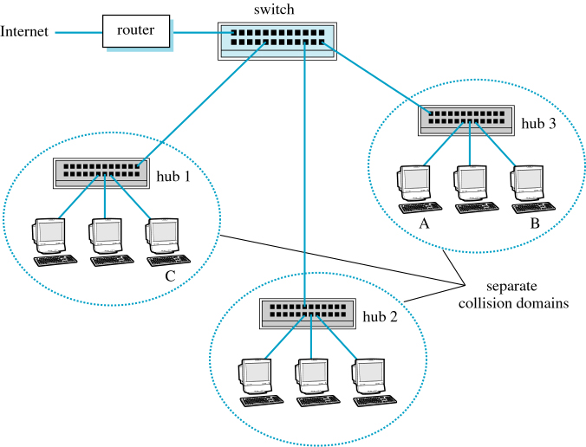
Switches & Switched Ethernet
switches are similar to bridges, with one primary difference
while a bridge can connect two LANs, a switch can connect multiple LANs through ports
Connections Using Hubs & Switches
Link Layer C

Slide 23
Switches & Switched Ethernet
although there may be many collision domains, a single broadcast domain can be defined
the destination MAC address in an Ethernet frame can specify either a device address or a broadcast address
a broadcast frame is forwarded over all ports and accepted by all devices
effectively, collision is now possible in a topology that uses hubs and switches (as in previous figure)

Slide 24
Switches & Switched Ethernet
a fully Switched Ethernet topology solves this collision problem
with Switched Ethernet, all hubs are replaced by switches
because switch ports lead to different collision domains, and each device is connected to a separate port, there is no more collision anywhere
furthermore, if connection between the device and the switch operate in full-duplex mode, there is no more need for CSMA/CD
each device is still capable of communicating with any other device, broadcast domain is also still there; there is just no more collision problems

Slide 25
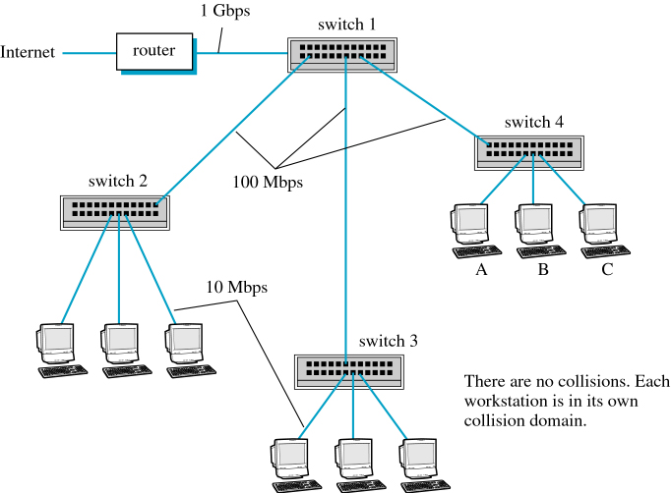
Switches & Switched Ethernet
another advantage of Switched Ethernet is that the bit rate for ports can vary
Connections Using Only Switches

Slide 26
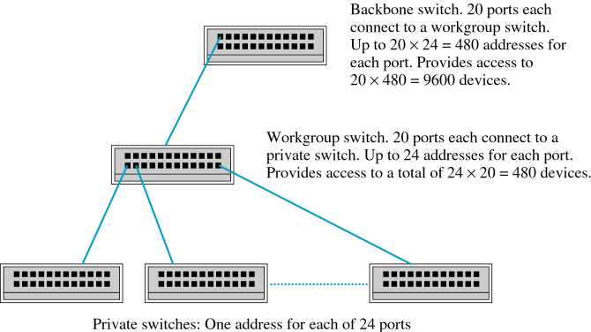
Switches & Switched Ethernet
Multiple layers of switches are also possible
Private, Workgroup & Backbone Switches

Slide 27
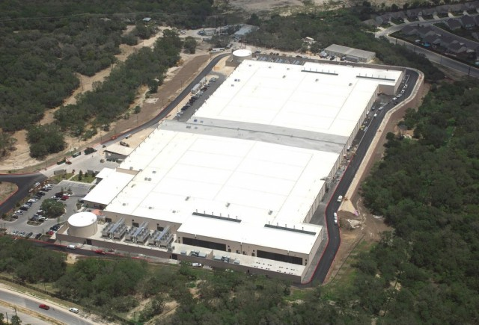
Data center networks
10’s to 100’s of thousands of hosts, often closely coupled, in close proximity:
Microsoft’s data center in San Antonio, Texas
Link Layer C

Slide 28

Data center networks
Concurrently supporting many cloud applications:
e-business
content-servers
search engines, data mining
E-mail servers
…
challenges:
multiple applications, each serving massive numbers of clients
managing/balancing load, avoiding processing, networking, data bottlenecks
Inside a 40-ft Microsoft container,
Chicago data center
Link Layer C

Slide 29
Data center networks
load balancer: application-layer routing
receives external client requests
directs workload within data center
returns results to external client (hiding data center internals from client)
Internet
Border router
Load
balancer
Load
balancer
Access router
B
Tier-1 switches
A
C
Tier-2 switches
TOR switches
Server racks
1
2
3
4
5
6
7
8
Link Layer C

Slide 30
Data center networks
Problem: Limited host-to-host capacity!
suppose each host communicates with TOR with 1Gbps link, whereas links between switches are 10 Gbps
Two hosts in same rack can communicate with 1Gbps, but what is the rate between hosts in different racks if many simultaneous flows are there?
Internet
Border router
Load
balancer
Load
balancer
Access router
B
Tier-1 switches
A
C
Tier-2 switches
TOR switches
Server racks
1
2
3
4
5
6
7
8
Link Layer C

Slide 31
Data center networks
Problem: Limited host-to-host capacity!
assume each 10 hosts in rack 1 send to the 10 hosts of rack 5
similarly assume hosts in rack 2, 3 and 4 send to 6, 7 and 8 respectively, so there is 40 simultaneous flows through links A-B and B-C
each of these 4 flows will receive 10G/40 = 250 Mbps, which is much less than the 1Gbps within the same rack
Internet
Border router
Load
balancer
Load
balancer
Access router
B
Tier-1 switches
A
C
Tier-2 switches
TOR switches
Server racks
1
2
3
4
5
6
7
8
Link Layer C

Slide 32
Data center networks
Problem: Limited host-to-host capacity!
the problem become more acute for flows between hosts that need to travel higher up the hierarchy
supporting high-bandwidth for host-to-host communication is important
i.e. a search engine may run on thousands of hosts spread across multiple racks with significant bandwidth requirements between the all pairs of hosts
Internet
Border router
Load
balancer
Load
balancer
Access router
B
Tier-1 switches
A
C
Tier-2 switches
TOR switches
Server racks
1
2
3
4
5
6
7
8
Link Layer C

Slide 33
Trends in data center networking
fully-connected topology
Now, there are 4 distinct paths between A and C, providing an aggregate capacity of 40 Gbps
such design not only alleviates the host-to-host capacity limitations but also allows communication between hosts in any two racks, not connected to the same switch, to be logically equivalent, irrespective of their location in the data center
Tier-1 switches
A
C
Tier-2 switches
TOR switches
Server racks
1
2
3
4
5
6
7
8
Link Layer C

Slide 34
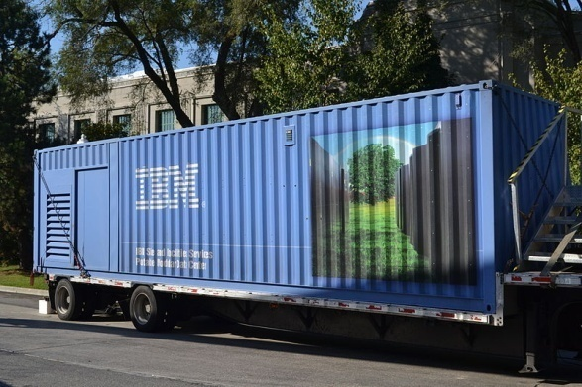

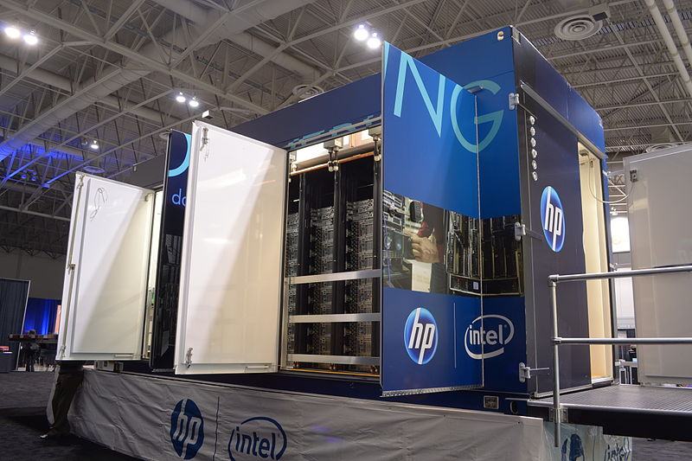
Trends in data center networking
shipping container-based modular data centers
employ standard 12-meter shipping container as a mini data center
1000s of hosts packed in racks closely to each other
at the data center, containers are interconnected to each other and the Internet
at the scale of few thousand hosts, it is possible to build a fully-connected network
however, interconnecting 100s to 1000s of containers while providing host-to-host bandwidth remains a challenge
Link Layer C

